Slide 1

Best spots to stay on a summer trip to Toronto
Report prepared by:
Webster Gova
Sterv.AI Consulting Group

Slide 2

Business problem
A travel agent conducted a survey to help them plan a trip for a group of students from Stellenbosch University to visit Toronto. In the survey, the agent asked the students what facilities and activities they’d like to do while in Canada. The results in the survey showed that the students prefer to stay in Central Toronto.
The agent then sent results of the survey to our consulting company (StervAI) to analyse the results and recommend boroughs to get the students accommodation in Central Toronto

Slide 3
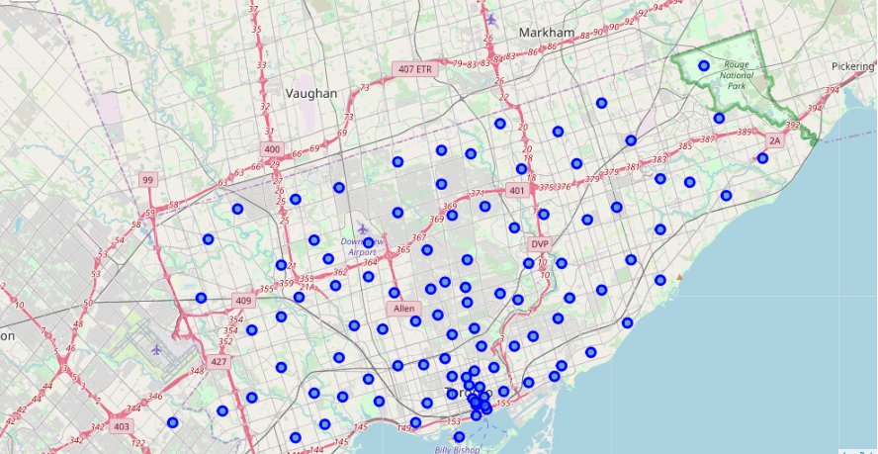
Postal code geo-location references to Toronto Boroughs

Slide 4
Data requirements
The data required for this project include:
Geo-coordinates for the recreational activities, amenities and facilities gathered by the travel agent in the survey (location data will be obtained from Foursquare venues API)
Geo-coordinates for borough and neighborhoods in Central Toronto (obtained from Wikipedia Toronto postal codes)

Slide 5
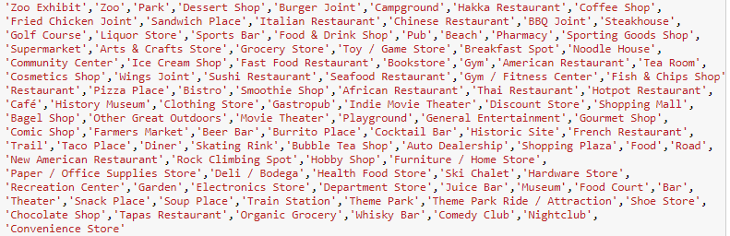
Data requirements
Activities, amenities and facilities the students prefer to be in close proximity to include the following venues geo-location matches in FOURSQUARE:
The venues location data will be matched to the Boroughs location data to calculate Boroughs location clusters with the highest proximity to most venues
The best Boroughs location cluster will be identified using a k-means clustering model

